Slide 1

Introduction to WEST
Shared Responsibility and Investment
in Journal Print Preservation and Access
Alison Wohlers – WEST Program Manager
Nika Burns Teshin – WEST Analyst
Monday, February 2, 2026
Presentation to CARLI Members
Notes:
Alison
[greetings & thanks!]

Slide 2
WEST Presentation Roadmap
What is WEST
WEST by the Numbers
What the Trust provides
What’s happening in 2026-2027
Membership and Cost-share
CARLI Member Questions
Notes:
Alison
Today’s presentation will be about 30 minutes and then we’ll have at least 20 minutes for questions. Please feel free to drop questions and comments in the chat as we go.
I’ll start things off by laying out the basics of shared print as WEST engages in it. Then we’ll get into the specifics of WEST as a shared print program, what we offer through the trust, and the exciting things that are coming up this year and next year. We’ll end the presentation with details about membership and the cost-share that supports the program.

Slide 3

What is Shared Print?
A formal agreement
Assurance of continued access
Augments local capacity
Notes:
Alison
So what is shared print? Shared print can have a lot of permutations, but it often (and in the case of WEST):
A formal agreement to specify responsibility for print collections
Assurance of continued access to print resources across a network of institutions (which is unique from ILL and resource sharing agreements) - shared stewardship and decision-making about collections
And as a result of these first two pieces - the formal agreement to preserve and the assurance access, shared print collections become a solution that augments local capacity for strategic collection management and development

Slide 4
What is WEST?
A trusted, regional network for print serials and journals that serves libraries large and small by
ensuring preservation;
enabling access; and
empowering data-informed decision-making.
Notes:
Alison <1
Boiling it all down, what is WEST? We are a trusted, regional network (that is also embedded in a larger national network) for print serials and journals that serves libraries large, small, and everything in between by:
ensuring preservation;
enabling access; and
empowering data-informed decision-making for individual libraries and groups of libraries (and that spans a spectrum of identifying what’s scarce and unique in a collection, facilitating decision-making about what to keep, and supporting informed deselection or weeding efforts)

Slide 5
What is WEST - Collection & Risk Model
Risk profile | Risk level | Title Category | Validation | Archiving members
Print & electronic full text in trusted digital repositories (e.g. CLOCKSS, Portico, JSTOR, HathiTrust Digital Library) | Low | 1, 6 | No validation required | Archive Holders Archive Builders
Print with electronic abstracting or indexing or no electronic coverage at all, not held by an archive builder. | High | 2 | No validation required | Archive Holders
Print with selected text access through databases | Medium | 3 | Physical validation required | Archive Builders
Print with electronic abstracting or indexing or no electronic coverage at all | High | 4, 5 | Physical validation required | Archive Builders
Notes:
And before we get into some numbers, I want to provide some scaffolding for an aspect of WEST that is going to keep coming up in different ways. WEST is distinct in the collection and risk model that we use to target our efforts. As part of our collections analysis and proposal process we sort the serial and journal titles into categories of risk based on electronic availability. The lowest risk content is characterized by availability in trusted digital repositories including Portico, CLOCKSS, the HathiTrust Digital Library, or JSTOR. For low risk materials we have agreed as a community that the right level of effort to be that retention commitment and disclosure of it in national registries and any library in our the WEST trust network is eligible to commit to retain this content.
Medium and high risk titles are characterized by having some full text availability in commercial databases, abstracting and indexing only, or no electronic presence that we are able to discern through our matching processes. So for these categories of content we as a collaboration are investing more to ensure that they truly exist, are as complete as possible, and are more protected. We do that through physical validation of the materials, transfer to storage, and active gap-filling; those retaining higher risk materials seek out missing volumes from the rest of the trust network using reports and data comparison tools that we provide. There are fewer libraries across the trust network who do this work because it requires specific training for validation and a storage facility that meets WEST’s environmental and security standards. The work is also subsidized on a per volume basis by the collective investment of WEST members.

Slide 6
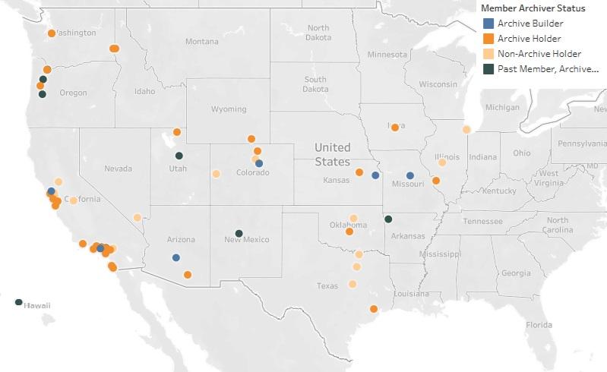




WEST by the Numbers - Member Libraries
61 members across 18 states
Notes:
Alison
Ok let’s get into some numbers. WEST members include total 61 libraries across 18 different states and the majority of WEST members serve as either archive holders or archive builders. We also have some members who are not able to retain materials on site, but they contribute significantly by donating volumes to complete the archived runs of other WEST libraries and through strategic leadership in the program. I also want to acknowledge that we do have past members who continue to serve as archive holders because per the agreement this trust network is built on, commitments to retain survive membership. So if a library for whatever reason has to end their active membership in WEST and they are an archive holder, they continue to retain and provide access to those collections through the retention date.
Consortial membership and CARLI joining…

Slide 7
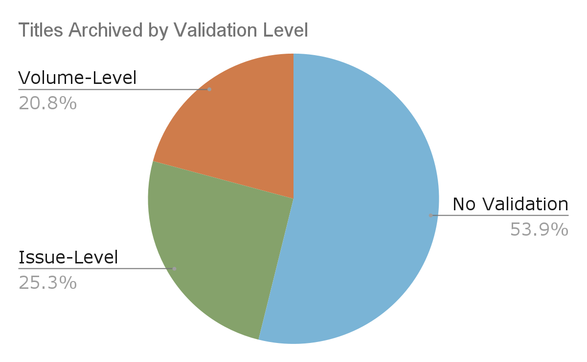
Archiving Progress Cycles 1-14
WEST Unique Archived Holdings
No Validation | 21,367
Volume Level | 8,259
Issue Level | 10,043
Grand Total | 36,669
Over 834,000 volumes!
Notes:
Nika (30sec)
This model has served us very well. Since Cycle 1 (in 2011), WEST members have archived nearly 37,000 distinct titles. Roughly half of the WEST Archives are low risk level materials (archived with no validation or storage requirements), with the remainder split fairly evenly between items validated at the issue level and items validated at the volume level.
And all of this equates to over 830k volumes! And Cycle 15 archiving is currently underway, so these numbers will continue to go up.

Slide 8

WEST by the Numbers
WEST members report deselecting over 367,000 volumes from titles archived by WEST
That’s about 10 miles worth of reclaimed linear space
Notes:
Alison
Note that this is only what has been reported - it’s likely a conservative number and there’s a lot more potential space members could choose to repurpose on the strength of the WEST trust network.

Slide 9
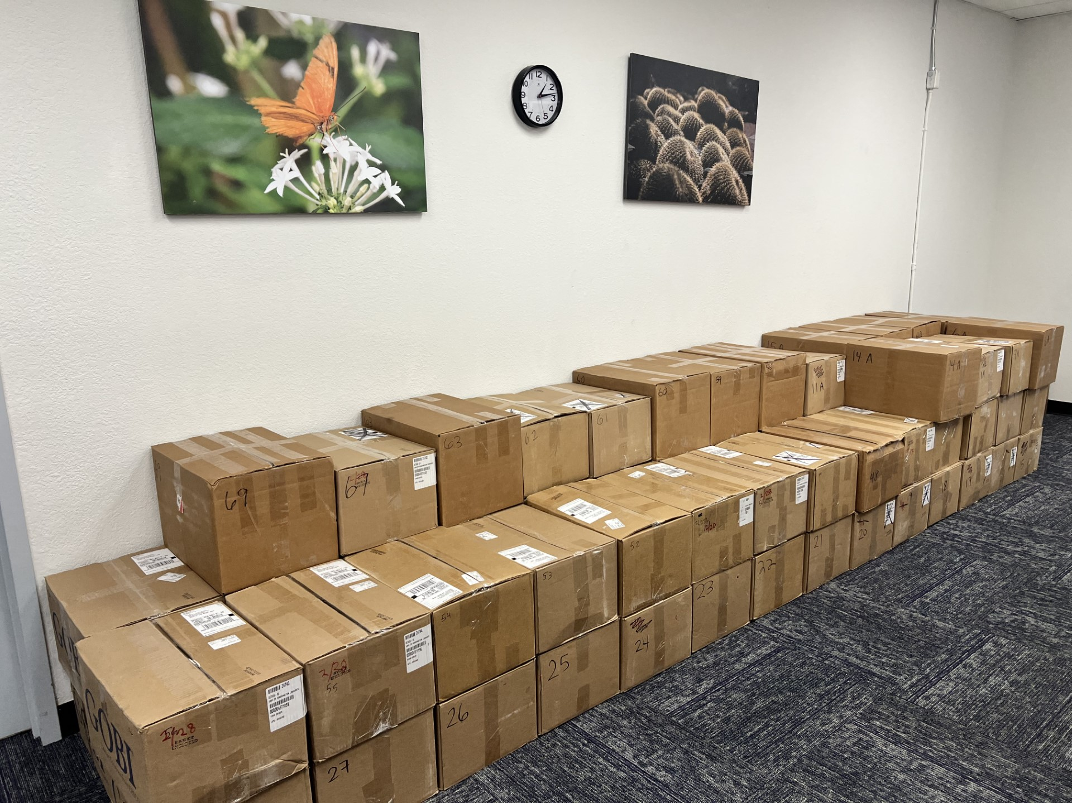
WEST by the Numbers - In Action!
University of Washington and Arizona State University collaborated to complete WEST print archives:
UW sent ASU 87 boxes of materials to fill gaps in archived titles!
Notes:
Alison
And I want to give you an example of this network in action. Arizona State University is one of our long-standing Archive Builders, working with that higher risk material and actively completing runs. University of Washington is an archive holder, but also is very active in comparing the collections they have not committed to retain to the rest of the WEST archive and where they can fill gaps, they always do. They’ve contribute material to fill gaps across the WEST network, and this is just one example.

Slide 10
What the trust network provides members
Notes:
And now I’m going to turn it over to Nika to go over in more detail what the trust network provides to its members.

Slide 11
Collections Analysis for Serials & Journals
Bib and holdings data ingest, enhancement, and group analysis
Established workflows and standards
Notes:
Nika!
Ongoing collections analysis is a significant benefit for WEST members and area of focus for the program. It’s a huge job to deal with serials data, to consolidate the bibliographic and holdings data from individual libraries, to transform that data to a point where it can be analyzed across a group of libraries, to enhance it with data from sources that support decision-making, and then to analyze it in an automated way to prioritize what we archive and who is best positioned to archive it. WEST does this every other year using an in-house tool called AGUA, which was built for and continues to be controlled by WEST and its member libraries. So with AGUA WEST has a say in what features are developed and prioritized to support this collections analysis work.
This analysis is focused regionally, but is informed by the national context - by what has been retained by other programs, how many copies appear in WorldCat, and what is available in trusted digital repositories.
And then of course having solid, established workflows, standards, policies, and practices provides members with the assurance they need to make decisions and take action based on WEST’s archived collections.

Slide 12
What do libraries need to do to participate in collections analysis and archiving?
Group collections analysis
Submit MARC bibliographic and holdings data for your print serials
Archiving (also known as retention)
Complete holdings record updates & submit data for national registries
Members can choose to archive a lot, a little, or nothing at all
Notes:
What do libraries have to do to participate?
At the beginning of the process what we need from libraries is the ability to export their bib and holdings data
For archiving
If you commit to archiving titles -
Update the local holdings record per our detailed disclosure guidelines - generally the fields we’re talking about include the MARC 583, 561, and 852; In Alma now you can set a retention flag and reason, but that’s up to the local institution, that particular field in Alma is not tied to MARC 583 field which is the predominant field that libraries use to record shared print commitments
Once the libraries have made those updates, we request a yearly submission of that data to include in our regional system, and which we forward to the Center for Research Libraries national print archive preservation registry (or PAPR); and we ask the libraries to also disclose to the OCLC shared print registry (and there’s a lot of great documentation to support this process)
We have a pretty easy system to support data file uploads and error reporting; we also have dedicated time from a very experienced metadata analyst who can work with members to troubleshoot metadata issues and knows a lot about different ILSs; we also have a kind of community of practice in which WEST members share workflows with one another that they’ve devised for doing these things in Alma and other ILSs efficiently
– Past Questions
Will a comprehensive inventory of our holdings be required to participate? If so, what is the timeframe for this to be completed?
No, I wish we could all get behind a comprehensive inventory, but we know it’s realistic for most libraries
Participating in a shared print program like WEST means that you can target your inventory to those journal families that you have been identified as the optimal holder - it’s almost like in shared print we try to obviate the need for a comprehensive by sharing responsibility
We are a very small college library (FTE 3200) and don't have room for much serial growth. Do members/participants have to agree to store/archive some titles or can they rely on other institutions for storage?
The sort answer is no. In WEST’s model libraries participate in alignment with their capacity. Archiving commitments across WEST libraries range from thousands to under ten to none depending on the collections and capacity of the members. We are trying to expand the scarce and unique content in the collection and that can be relevant and mission-aligned for all libraries large to small.

Slide 13

Discovery & Access
Discovery is essential
Disclosure of archived holdings in local systems, OCLC, and shared print registries
Opportunities for local discovery
Support for resource sharing
OCLC Profiled Group
RapidILL pod
Notes:
Nika!
The other piece that really helps libraries feel able to take action on the strength of the WEST collection is the guarantee of access. WEST members agree to share archived collections with other WEST members, leveraging their regular access policies and methods.
The WEST network complements existing resource sharing networks with the guarantee that the print collections will continue to be available in the long term. Which goes beyond other resource sharing relationships where you’re all managing your collections separately.
And we continue to investigate and pursue ways of improving discoverability and access for shared print through collaborations with other library initiatives and vendors.
–
CARLI Access questions
If a WEST participant needed access an article, are there any ILL fees charged from the Archive Holder to the WEST participant asking for the materials?
There can be - WEST members leverage their own lending policies and that includes any fees
they need to charge
Also, is there a standard turn-around time for these ILL requests?
It varies, again, it’s based local policy; there is a WEST RapidILL pod and so the turnaround time when
requesting through that platform the norm I believe is less than 24 hours
Are participants able to request ILL for materials that they never owned?
Yes. Absolutely. This is part of the beauty of collective collections like WEST. You can strategically maintain
access to content you withdraw, but you also gain access to content you’ve never had before.

Slide 14

Data-Informed Decision-Making
Easy to use tools and reports
Retention & deselection
Collection comparison at any time
Metadata validation
Notes:
Nika!
We strive to make the WEST archives actionable for members through analysis tools and canned reports. With these tools, members can compare their local holdings against the archives at any time and use that information to make decisions about what to keep and what might better be accessed through the WEST trust network. As part of working with member data for collections analysis, we also provide members with metadata validation reports that catch common errors in catalog records.
WEST has also built in the development capacity necessary to respond to member needs and to continually improve existing tools and reports. Which is one of the benefits we mentioned earlier of working with our in-house tool AGUA.

Slide 15
What’s coming up
Summer 2026
WEST Member Meeting
Next set of archiving proposals go out to members (following group collections analysis and prioritization)
Fall 2026
Annual Comparison Reports
New Customized Infographics
Executive Committee Elections
Winter 2026/2027
HT, CDL, WEST Pilot Wrap-up - adding HT mono shared print to our tool!
WEST Tool Development Phase
Notes:
Alison
Coordinate the Donation of Duplicate Copies to Internet Archive
WEST identifies and coordinates the donation of duplicate print materials to Internet Archive for digitization and aspirational deposit in HathiTrust to complement the print WEST archived collections.
Pilot participants have almost finished their selections for what to donate; shipping should begin soon
Facilitate donations from member libraries to the Internet Archive and, if possible, deposit of digital files in the HathiTrust.
Group collections analysis
Fall - Data ingest and normalization
Spring - Group collections analysis
Summer - Archiving proposals
Between analyses there are still options for contributing
Fill gaps
Use comparison tools to identify what has not been committed already
Engage in local space reclamation/deselection projects against the WEST archive
Proactive local commitments

Slide 16
Membership and Cost Share
How member fees are calculated and assessed
Fees are tiered
Three-year average of total library expenditures data
Annual 3% increase to account for inflation
WEST is supported by
Financial cost-share (member fees)
In-kind contributions by members
Consortial membership
Opt-in
Single agreement
Consolidated invoicing
Consortial vote
What WEST member fees support
In-house technology & analysis
Program management
Archive creation
Membership years begins July 1
Opportunity to join mid-year
Notes:
Alison
The shared responsibility and collective action of WEST is supported by a combination of a financial cost share (member fees) and in-kind contributions by members.
We budget very closely to what our operating expenses are as a program. We’ve kept the membership fees steady and as low as possible - even lowering fees in 2020 by 15% in the context of the developing impacts of COVID-19.
WEST member fees are fixed and tiered. Tiers are assigned on the basis of total library expenditures - an average of 2019, 2020, and 2021. The norm is for WEST to increase fees by 3% annually to account for inflation.
WEST member fees support our in-house technology infrastructure and data analysis tools, program management (including things like governance, producing resources for members, program assessment, and integration with national initiatives), financial management, and also archive creation (that is, physical validation, consolidation in storage, and gap-filling for higher risk titles).

Slide 17
Membership Fee Table
Tier | FY25-26 |  | FY26-27
 | If Avg Total Library Expenditures are more than* | Member Fee | If Avg Total Library Expenditures are more than* (2.86% increase) | Member Fee (3% increase)
Tier 1 | $ 1 | $ 695 | $ 1 | $ 716
Tier 2 | $ 500,000 | $ 1,421 | $ 514,300 | $ 1,464
Tier 3 | $ 1,000,000 | $ 2,816 | $ 1,028,600 | $ 2,901
Tier 4 | $ 2,500,000 | $ 4,411 | $ 2,571,500 | $ 4,543
Tier 5 | $ 5,000,000 | $ 6,840 | $ 5,143,000 | $ 7,046
Tier 6 | $ 10,000,000 | $ 10,160 | $ 10,286,000 | $ 10,465
Tier 7 | $ 15,000,000 | $ 15,330 | $ 15,429,000 | $ 15,790
Tier 8 | $ 20,000,000 | $ 20,179 | $ 20,572,000 | $ 20,784
Tier 9 | $ 25,000,000 | $ 23,463 | $ 25,715,000 | $ 24,167
Tier 10 | $ 30,000,000 | $ 25,810 | $ 30,858,000 | $ 26,584
Tier 11 | $ 60,000,000 | $ 28,391 | $ 61,716,000 | $ 29,242

Slide 18
We invite you to join us
WEST is a trusted network for serials and journals that services both large and small libraries by
ensuring preservation;
enabling access;
empowering data-informed deselection;
and more!
Notes:
We invite you to join us! Broadening the WEST Trust Network increases the preservation of scholarship, cultural heritage works, and the breadth of knowledge captured in print serials and journals. Through collaboration, we ensure access to content that otherwise might not be available to future researchers. We also empower libraries to make data-informed retention and deselection decisions, improving their ability to intentionally participate in print collection management, while maximizing the value of the space they utilize for physical collections.

Slide 19
Questions?
Notes:
Questions from Presentation:
What does CARLI Consortial membership mean for an individual library?
CARLI has done the paperwork and gone through procurement - invoicing will be in consortial manager and similar to other resources through CARLI
How will using IPEDs data going forward look like should IPEDs cease to exist?
Will be looking into this as part of member fee discussion in 2025.
Is there a minimal commitment for WEST to control member changes?
There is a three year minimal commitment to support consistency in services.
Would you be able to clarify the physical storage aspect? We have a number of periodicals in a storeroom that is not ideal for print volumes and are interested in WEST as an alternative storage location
Referred to bonus slides.
Can we upload our serial holdings at any time?
Yes and no. There are two ways to do this. For group collections analysis this happens during the dedicated two year cycle. But we do have the On Demand Comparison Report to enable numbers compare their serials holdings data to other WEST members at any time.
I assume the answer is probably no, but is there a way to see what the holdings are before joining?
Yes! PAPR - http://papr.crl.edu/tools/compare
If someone decided to join, what would be the first steps after paperwork and fees?
Typically WEST likes to do a 1:1 or small group orientation to go over different aspects of the program do some demoing of the tools and answer specific questions. Nika and Alison are here as resources to answer questions and point to WEST aspects which will be the most useful.
If you’re on the cusp of a big serials review project you can jump right into the on demand collection comparison report - and if you join this year we will be shortly sending out the call for bib and holdings data in Fall 2025.
Which CARLI member libraries have high density storage facilities?
Assumption is the University of Illinois and University of Chicago - both BTAA members and UI is already holding print journal archives on behalf of the BTAA program. About half of the collection falls into this high risk storage category but the other half is still just as available.
The WEST website has a wealth of information, what about communications resources?
Deselection Webinar: https://vimeo.com/854502345
Deselection Resource List: https://docs.google.com/spreadsheets/d/e/2PACX-1vRgEEDBVQU9RVBONoWeNyICeMkOE4sr_ZppHOkYRaJDcOBJYwz9PnHBmaexOAqitr3WzxR55V9X1xaX/pubhtml
Weeding Communications in the Collections Lifecycle (provides information for how to answer common questions about weeding): https://drive.google.com/file/d/1kqcqtEIejXsk3g6cL51hS9Br5Qz-c6MK/view?usp=sharing
Current retention date is 2035, is WEST planning to extend that?
Many programs are thinking about extending their dates now, this is on our Executive Committee and Operations and Collections Council agendas for this year. We want to be prepared and ten years out is a good time to start thinking about this to ensure the guaranteed and continual access of WEST.
What does access really look like?
Through ILL! WEST has a Rapid Pod libraries will be added to automatically and then there is also an OCLC profile group - so this is enabled through the regular mechanisms of ILL. But WEST is still looking into enhancing discoverability and enhanced ILL sharing. https://cdlib.org/cdlinfo/2021/10/20/spotlight-on-agua-development-enhancing-local-discovery-of-shared-collections/
Libraries don’t need to have held these titles before in order to access them through WEST!

Slide 20
Thank you!
Please stay in touch with your questions and feedback.
Alison Wohlers, WEST Program Manager
alison.wohlers@ucop.edu
Nika Burns Teshin, WEST Analyst
nika.worth@ucop.edu
https://cdlib.org/west/

