Slide 1
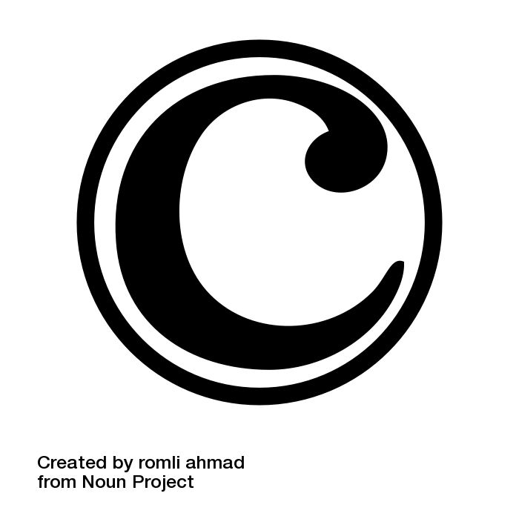
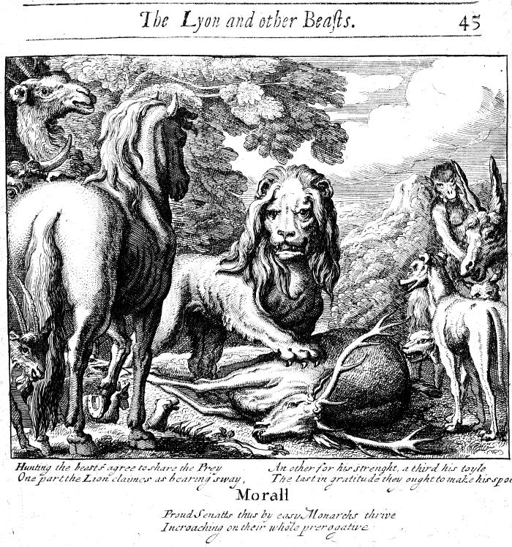
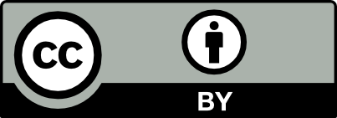
Copyright
By Marisa Walstrum
Francis Barlow, Public domain, via Wikimedia Commons
"Copyright" by Marisa Walstrum is licensed under Creative Commons Attribution 4.0 (CC BY 4.0)
Notes:
The Lion’s Share relates to copyright in that the one (creator) who does the work gets the benefits of the copyright protection, hence the reference to The Lion’s Share. Image Credit: Francis Barlow, Public domain, via Wikimedia Commons
Copyright Icon image credit: Copyright by Romli Ahmad from Noun Project. CC BY 3.0

Slide 2
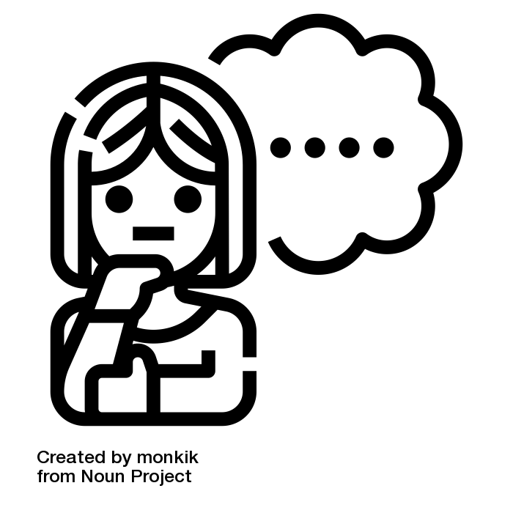
What is Copyright?
Copyright is legal protection for original works in a fixed state₁ to the creator(s) for a period of time
Copyright places value on creativity and gives recognition to the creator by granting exclusive rights
It protects a creator’s ability to profit from their work, and guarantees rights to the such as how works are disseminated (sale, licensing, etc); allows creation of derivative works based on that original, perform or display the work and make copies of the work
Currently the term of copyright exclusive protection is for the life of the creator plus 70 years in the United States
¹Copyright is automatic but in the United States it only applies to works in a “fixed state”. “[2.1 Copyright Basics]” (https://certificates.creativecommons.org/cccertedu/chapter/2-1-copyright-basics/) by Creative Commons. CC BY 4.0.
Notes:
the purpose of copyright,
what is copyrightable and what is not,
Sources:
“[2.1 Copyright Basics]” (https://certificates.creativecommons.org/cccertedu/chapter/2-1-copyright-basics/) by Creative Commons. CC BY 4.0
https://www.copyright.gov/what-is-copyright/
Image Credit: Thinking by monkik from Noun Project (CCBY3.0)

Slide 3
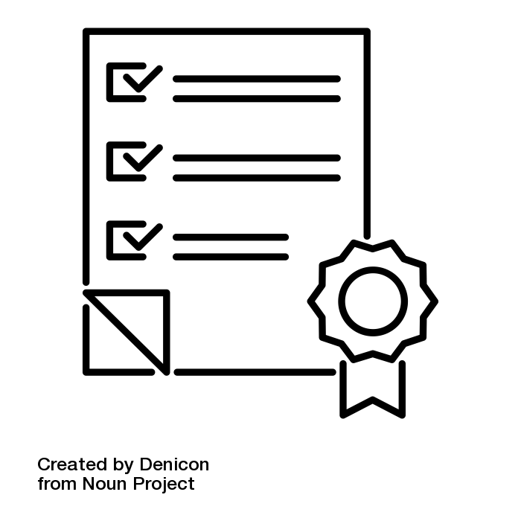
Copyright Eligibility
Original works that are in a fixed state include examples such as: photographs, literary works, maps, musical works and sound recordings, architectural works, and other works that can be reproduced or performed.
Copyright is assigned to the creator, or multiple authors/creators, or works can be created for hire as part of regular job duties would consider the rightsholder the employer.
Some items aren’t protected under copyright such as ideas, methods, names, familiar symbols, typographic lettering & coloring variations, lists of ingredients.
Notes:
how a person generally receives copyright protection for her work,
“if multiple authors contribute to a collective work, each author’s individual contribution is separate and distinct from the copyright ownership in the collective work as a whole.(Copyright Basics 3 copyright.gov) ”
Sources:
Image source: Check by Denicon from Noun Project (CCBY3.0)

Slide 4

Public Domain
Works with no copyright protections are considered in the public domain and have no restrictions for use
Works enter the public domain in a variety of ways, including:
  Works where the copyright has expired, usually the author’s lifetime plus 70 years in the United States
  The creator dedicates the work to the public domain using a license such as CC0
  Government works, records, and data are in the public domain automatically in the United States

Slide 5
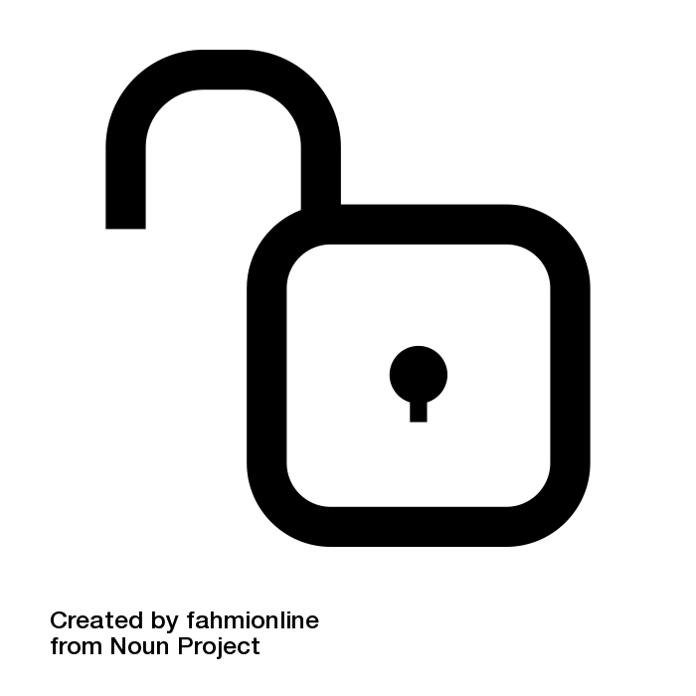
Finding Works in the Public Domain
Several projects host works in the public domain which you may already be familiar with including:
  Project Gutenberg
  Digital Public Library of America
  Library of Congress
  the Internet Archive among others
Look for the Public Domain Mark of CC0 symbol to identify public domain works.
Follow best practices by linking back to the institution that makes the work available digitally to identify the provenance of the work
Notes:
How to find works in the public domain?
Several projects host works in the public domain which you may already be familiar with including: Project Gutenberg, Digital Public Library of America, Library of Congress, the Internet Archive and many others. You can look for the Public Domain Mark of the CC0 symbol of reusing public domain works. You can also assign these symbols and dedicate your own works to the public domain! (Insert a picture of the public domain mark and CC0 to this slide). Finally, it’s good practice to identify the provenance of works by linking back to the institution that makes the work available.
Image Credit: Free by fahmionline from Noun Project (CCBY3.0)

Slide 6
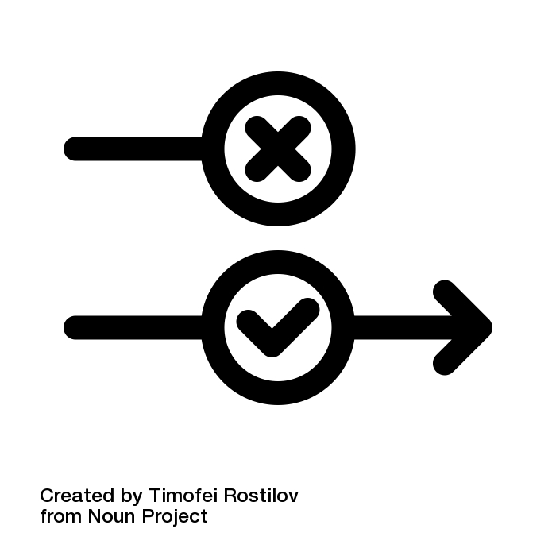
Exceptions and Limitations: Fair Use
Exceptions and limitations strike a balance between rights of the creator and users of the work to build new works
Fair Use is a legal doctrine that allows certain unlicensed uses of a work
Judges consider four factors to determine if a use of copyrighted material is considered fair use:
    the purpose and character of your use
    the nature of the copyrighted work
    the amount and substantiality of the portion taken, and
    the effect of the use upon the potential market.
Notes:
exceptions and limitations to copyright allow users to make use of materials while protecting the rights of the creator and ensuring that the
Fair Use
Questions: Is your use of this work transformative, for example: a parody; or building on existing knowledge for research and scholarship; What’s the nature of the work? Is it already published and has the creator had the first chance to display or perform the work prior to your use of it?; Are you duplicating the entire work, or just part and how significant is the part you will use? Is your use preventing the copyright owner from profiting from their work?
Sources: Fair Use Checklist from Columbia University https://copyright.columbia.edu/basics/fair-use/fair-use-checklist.html
Creative Commons. Exceptions and Limitations to Copyright. https://certificates.creativecommons.org/cccertedu/chapter/2-4-exceptions-and-limitations-to-copyright/
Image Credit: exception by Timofei Rostilov from Noun Project (CCBY3.0)

Slide 7
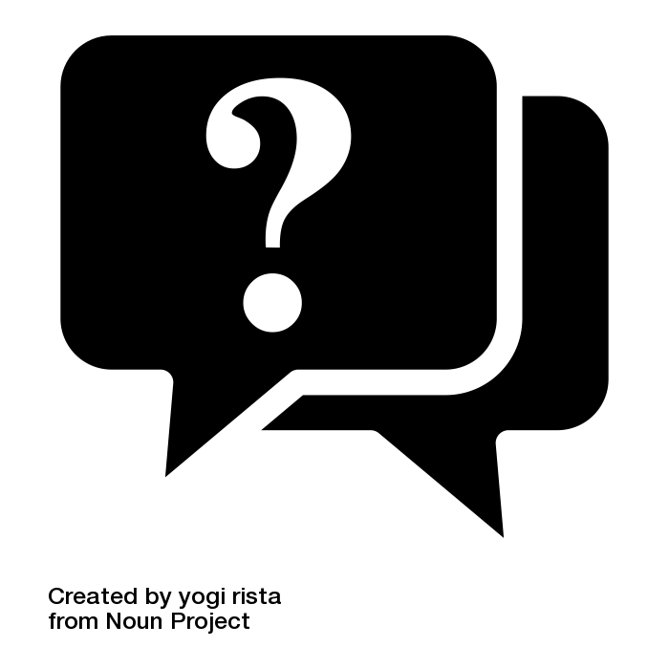
Is it a fair use?
Ask yourself some questions to determine if it’s fair use:
  Is the use transformative?
  Is the original work already published? Is your use for commercial or nonprofit/educational purposes?
  How much of the work are you using and how substantial is that part?
  Does your use impact the original creator from profiting from their work?
Keep in mind that use of copyrighted materials included in electronic resources through the library is determined by licensing terms that determine how users may make use of the work. If you’re unclear about the use of a work for scholarship or teaching please reach out to your Oakton librarians.
  Tip: Rutgers University Library has excellent guidelines for making an assessment on fair use in the Learning Management System
Notes:
Questions to consider and context for this slide build upon Colombia University’s Fair Use Checklist: https://copyright.columbia.edu/basics/fair-use.html
Image Credit: Question by yogi rista from Noun Project (CCBY3.0)

Slide 8
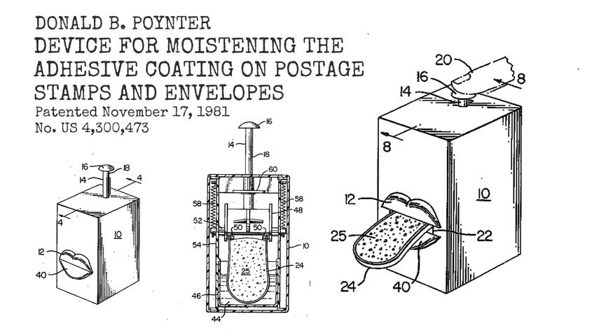
Intellectual Property Protections
Creators have protections over their creative an intellectual works other than copyright which may be taken into consideration by users of that content
  Trademark law - generally related to the producers of brands so that users know the real provenance of the work. Example: a designed brand name
  Patent law - generally relates to inventions or other technology and grants exclusive rights to the creator to make or sell or use the invention for a limited period of time. Example: “Device for Moistening the Adhesive Coating on Postage Stamps and Envelopes” (1981)
Poynter, Donald B. (1981). Apparatus for Moistening the Adhesive Coating on a Postage Stamp [image]. World Intellectual Property Organization. https://www.wipo.int/patents/en/2022_patent_picks.html
Notes:
Image source credit: Donald B. Poynter. “Device for Moistening the Adhesive Coating on Postage Stamps and Envelopes” (1981). Accessed from https://www.wipo.int/patents/en/2022_patent_picks.html
“Do you like sending handwritten letters but dislike the taste of envelope and postage stamp glue? In 1981, Donald B. Poynter patented a solution: ‘an apparatus for moistening the adhesive coating on a postage stamp, envelope or the like.’” This invention allowed an application of moisture without having to lick an envelope and the inventor had protection for the commercial distribution of their invention through gaining a patent.

Slide 9
References
“[2.1 Copyright Basics]” (https://certificates.creativecommons.org/cccertedu/chapter/2-1-copyright-basics/) by Creative Commons. CC BY 4.0
Berne Convention for the Protection of Literary and Artistic Works. (n.d.). Retrieved June 22, 2023, from https://www.wipo.int/treaties/en/ip/berne/index.html
Stanford Copyright and Fair Use Center. (2013, April 4). Measuring Fair Use: The Four Factors. Retrieved June 30, 2023 from https://fairuse.stanford.edu/overview/fair-use/four-factors/
U.S. Copyright Office Fair Use Index. (n.d.). Retrieved June 26, 2023, from https://www.copyright.gov/fair-use/
What Does Copyright Protect? (FAQ) | U.S. Copyright Office. (n.d.). [Web page]. Retrieved July 1, 2023, from https://www.copyright.gov/help/faq/faq-protect.html
What is Copyright? | U.S. Copyright Office. (n.d.). Retrieved June 30, 2023, from https://www.copyright.gov/what-is-copyright/

