Slide 1
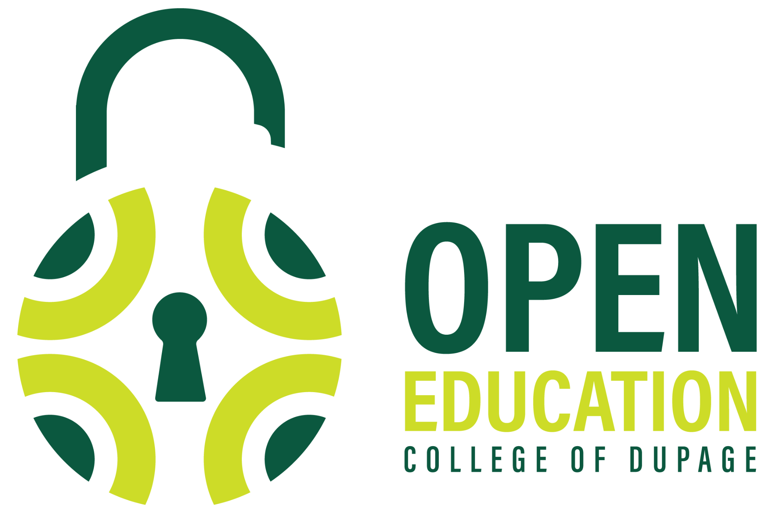
Copyright and the Creative Commons: The Basics
Lauren Kosrow
Digital Content and Open Access Librarian
This work is licensed under a Creative Commons Attribution 4.0 International License.

Slide 2
The Story of Creative Commons

Slide 3

The Story of Creative Commons
The internet has given us the opportunity to access, share, and collaborate at an unprecedented scale
The sharing capabilities made possible by digital technology are in tension with the sharing restrictions embedded within copyright laws
Creative Commons was created to help address the tension between creator’s ability to share digital works globally and copyright regulation
The Story of Creative Commons, by Creative Commons. CC BY 4.0.

Slide 4
It all started with a mouse…
In 1998, the Sonny Bono Copyright Term Extension Act (CTEA) was enacted, which extended the term of copyright for every work in the US for an additional 20 years
  Copyright term for individuals equaled life of the creator plus 70 years
CTEA was commonly referred to as the Mickey Mouse Protection Act
  The extension came just before the original Mickey Mouse cartoon, Steamboat Willie, would have fallen into the public domain
  Fun fact: Steamboat Willie will fall into the public domain on January 1, 2024
The Story of Creative Commons, by Creative Commons. CC BY 4.0.

Slide 5
Eldred v. Ashcroft
Lawrence Lessig represented a web publisher, Eric Eldred, who had made a career of making works available as they passed into the public domain
  Together, they challenged the constitutionality of the CTEA
The Supreme Court decision upheld the constitutionality of the act and extended copyright protections
The Story of Creative Commons, by Creative Commons. CC BY 4.0.

Slide 6
The Founding of Creative Commons
In response, Lessig and Eldred created a nonprofit organization called Creative Commons
They published the Creative Commons licenses in 2002
  Creative Commons licenses are a set of free, public licenses that allow creators to keep their copyrights while sharing their works on more flexible terms than the default “all rights reserved.”
The Story of Creative Commons, by Creative Commons. CC BY 4.0.

Slide 7
Creative Commons Today
Today, Creative Commons is a nonprofit organization that stewards the CC licenses and helps support the open movement
Creative Commons licenses are used on nearly 2 billion works online across 9 million websites
The open movement, which extends beyond just CC licenses, is a global force of people committed to the idea that the world is better when we share and work together
Creative Commons Today, by Creative Commons. CC BY 4.0.

Slide 8
Copyright and Creative Commons Licenses

Slide 9
What Is Copyright?
Copyright is the area of law that limits how others may access and use the original works of creators
Copyright grants a set of exclusive rights to copyright owners, which means that no one else can copy, distribute, publicly perform, or adapt the work without permission of the copyright holder
As a general rule, copyright is automatic the moment a work is created (and fixed in a tangible medium in the US)
Copyright Basics, by Creative Commons. CC BY 4.0.

Slide 10
The Purpose of Copyright
There are two primary rationales for copyright law:
  Utilitarian: purpose of copyright is to incentivize creators via the social benefits that come from those works, including commercial gains
  Author’s rights: copyright protection serves to recognize and protect the connection creators have with their works
Copyright Basics, by Creative Commons. CC BY 4.0.

Slide 11
Creative Commons Licenses
Creative Commons licenses give creators a clear, standardized way to grant permission to others to use their creative work
CC licenses answer the question, “What can I do with this?”
CC licenses ensure that creators retain their copyright and get credit for their work, while permitting others to copy and distribute it
Anatomy of a CC License, by Creative Commons. CC BY 4.0.

Slide 12
3 Layers of a CC License
The license are built using a three layer design:
  Legal code: contains the “lawyer-readable” terms and conditions that are legally enforceable in court
  Commons deeds: the web pages that lay out the key license terms in “human-readable” terms
  “Machine readable” version of the license: a summary of the key freedoms granted and obligations imposed written into a format that applications, search engines, and other kinds of technology can understand
License Design, by Creative Commons. CC BY 4.0.

Slide 13




CC License Elements
License Design, by Creative Commons. CC BY 4.0.
 | This symbol means Attribution or “BY.” All of the licenses include this condition.
 | This symbol means NonCommercial or “NC,” which means the work is only available to be used for noncommercial purposes. Three of the CC licenses include this restriction.
 | This symbol means ShareAlike or “SA,” which means that adaptations based on this work must be licensed under the same license. Two of the CC licenses include this condition.
 | This symbol means NoDerivatives or “ND,” which means reusers cannot share adaptations of the work. Two of the CC licenses include this restriction.

Slide 14
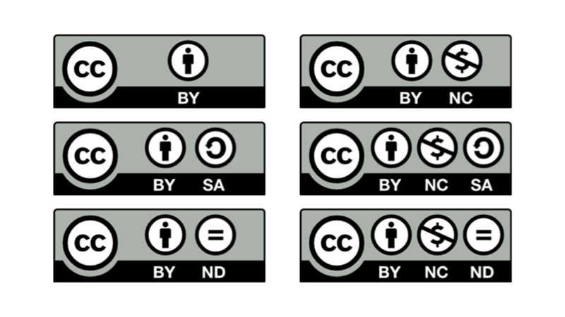
Six CC Licenses
The four license elements—BY, SA, NC, and ND—combine to make up six different license options
Six Types of CC Licenses, by CUNY. CC BY 4.0.

Slide 15
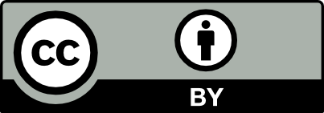

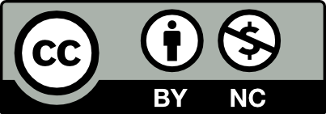

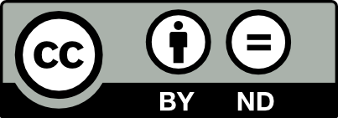
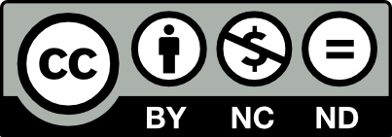
 | The Attribution license or “CC BY” allows people to use and adapt the work for any purpose (even commercially) as long as they give credit to the creator.
 | The Attribution-ShareAlike license or “BY-SA” allows people to use and adapt the work for any purpose (even commercially), as long as they give credit to the creator and make any adaptations they share with others available under the same or a compatible license.
 | The Attribution-NonCommercial license or “BY-NC”allows people to use the work, or adaptations of the work, for noncommercial purposes only, and only as long as they give credit to the creator.
 | The Attribution-NonCommercial-ShareAlike license or “BY-NC-SA” allows people to use and adapt the work for noncommercial purposes only, and only as long as they give credit to the creator and make any adaptations they share with others available under the same or a compatible license.
 | The Attribution-NoDerivatives license or “BY-ND” allows people to use the unadapted work for any purpose (even commercially), as long as they give credit to the creator. They may also adapt the work for their own personal use but may not share any adaptations publicly
 | The Attribution-NonCommercial-NoDerivatives license or “BY-NC-ND” is the most restrictive license offered by CC. It allows people to use the unadapted work for noncommercial purposes only, and only as long as they give credit to the creator.
Notes:
License Types, by Creative Commons. CC BY 4.0.

Slide 16
The Public Domain
The public domain consists of works that are not subject to copyright
  It is critical that copyright protection does not last forever
  After a set time (far too long under current copyright law in the US), copyright expires and the work enters the public domain
Works in the public domain fall outside the scope of copyright and are free to use, copy, adapt and share
The Public Domain, by Creative Commons. CC BY 4.0.

Slide 17


Public Domain Tools
CC also has two public domain tools represented by the icons below:
License Design, by Creative Commons. CC BY 4.0.
 | CC0 enables creators to dedicate their works to the worldwide public domain to the greatest extent possible.
 | The Public Domain Mark is a label used to mark works known to be free of all copyright restrictions and has no legal effect when applied to a work. It serves only as a label to inform the public about the public domain status of a work

Slide 18
Finding and Using
Open Educational Resources

Slide 19
Open Educational Resources (OER)
Open Educational Resources (OER) are teaching, learning, and research materials that are either in the public domain or licensed in a manner that provides everyone with free and perpetual permission to engage in the 5R activities (retain, reuse, revise, remix, redistribute).
OER, Open Textbooks, and Open Courses by Creative Commons. CC BY 4.0.

Slide 20
Open Educational Resources (OER)
OER are possible because:
many educational materials are born digital and digital resources can be stored, copied, and distributed for near zero cost
the internet makes it simple for the public to share digital content
Creative Commons licenses make it simple and legal to retain copyright and legally share education resources with the world
OER, Open Textbooks, and Open Courses by Creative Commons. CC BY 4.0.

Slide 21
Best Practices
Materials to Use
Public domain materials
Open Access materials (journal articles and books)
Creative Commons materials
Materials to Avoid*
Full copyright protected materials (assume this is the default!)
*Library materials are great resources that are free (to the student)

Slide 22
Best Practices
Check for:
  Relevance
  Accuracy
  Production quality
  Accessibility
  Licensing
Track attribution
  Essential component of this project
  Just like you cite sources in your professional work (and just like we ask students to cite theirs!)
Confirm license type with librarians

Slide 23
Best Bets
Open Repositories
COD Digital Press
OER Commons
Open Illinois Hub
Open Textbooks
Open Textbook Library
OpenStax
B.C. Open Textbook Collection

Slide 24
Best Bets
Images
Free Images
Unsplash
Nappy
Disabled and Here
Vintage Stock Photos
Music & Video
Khan Academy
Openverse
Free Music Archive
Bandcamp

Slide 25
How to Add a CC License to Your Work
If you are the copyright owner of your work, you can add a Creative Commons license to it at any time by including a few basic pieces of information in a copyright notice
  Title: The title of your work
  Author: Your name
  Source: A link to or notice regarding where your work can be found
  License: The specific Creative Commons license you’ve chosen for your work, including the version of the license. Also include a link (or other directions that guide users) to the legal code for the license.
“Marking your work with a CC license” by Creative Commons is licensed under Creative Commons Attribution 4.0.

Slide 26
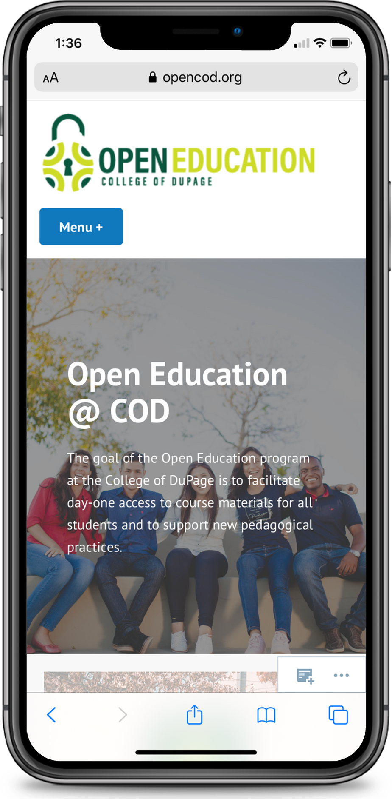
Learn more:
opencod.org

Slide 27
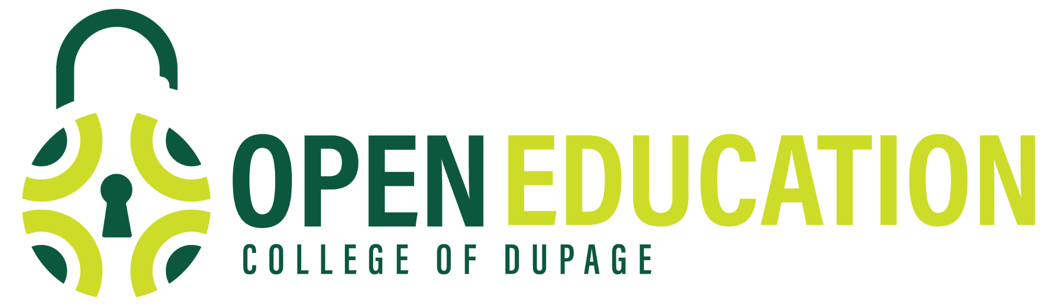
Thank you.
kosrowl@cod.edu

