Slide 1
Using CC Licenses and CC-Licensed Works
CC BY 4.0, 2023, Chris Chang
“Using CC Licenses and CC-Licensed Works” by Chris Chang is licensed under a Creative Commons Attribution 4.0 International License.
Notes:
Licensed under a Creative Commons Attribution 4 International License

Slide 2
Using CC Licenses

Slide 3
How to license your work
Is the work copyrightable? Some works cannot be copyrighted.
Do you have the rights? You might need permission from your employer, co-authors, or the copyright holders of the elements used in your work.
CC licenses are irrevocable. Creators can always stop making new copies available with a Creative Commons license, but they cannot stop anyone from relying on the old license.
Understand the terms of the license.

Slide 4
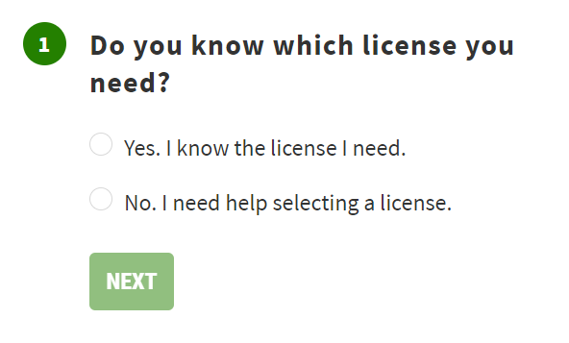
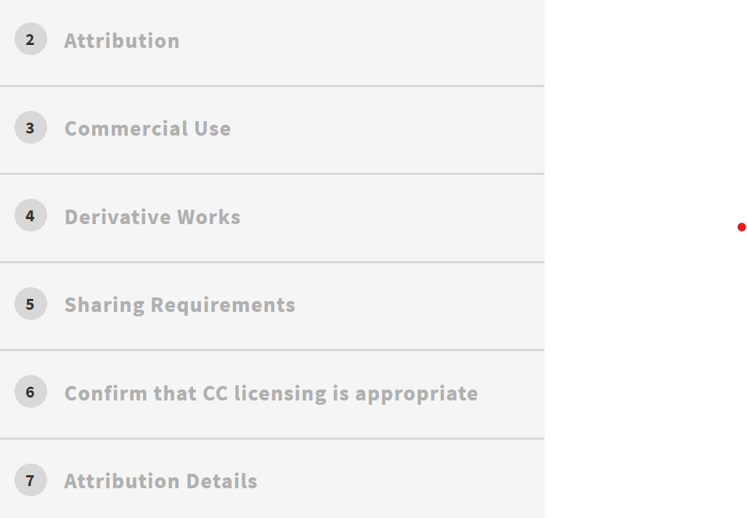
Choosing a CC license
Not sure which CC license to use? This tool by Creative Commons helps you to choose a CC license and create an embeddable CC license image.

Slide 5
Remixes and Collections using CC-Licensed Works

Slide 6
Collections & Adaptations
A collection takes individual creative works and inserts them into a collective piece, while keeping the original works intact (i.e., not edited, remixed, adapted).
When Creative Commons licensed content is used in a collection, providing attribution and indicating the license of the original works must be included for each work in the collection. It is important to pay close attention to the types of licenses included in a collection

Slide 7
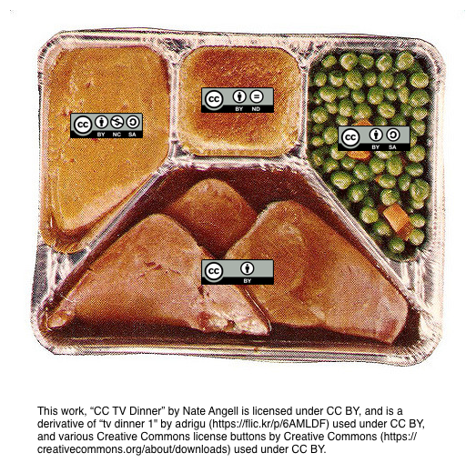
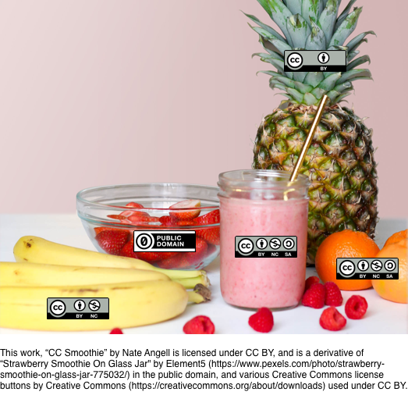
Collection vs Remix
A Collection
Think of it as a TV-dinner:₄
A Remix
Think of it as a smoothie:₄
Each work is independent from the others and has its own licensing and attribution information that reflects that.
Although the works are presented as a whole, there are divisions between each that show where one ends and the next begins.
While each work was originally independent, they’re now so mixed together that it’s nearly impossible to tell which pieces came from which.
Each work is still attributed as part of the whole, but now they’ve become something totally new and original.

Slide 8
Collection vs Remix: Licensing Issues
Licensing a Collection:
You must attribute each individual work, according to the terms of their licenses.
You can license the entire collection, but the license you apply ONLY covers the collection itself, NOT to the works within the collection.
However, your license cannot allow uses of the works you collected that those works’ own licenses don’t allow. (For example, if those works don’t allow commercial uses, your collections’ license can’t allow commercial uses either. For more, check this chart.)
Licensing a Remix:
You must state that the new work is a derivative work and attribute each individual work it was based on (or is a remix of).
You can license the new remix you’ve created, but the license you choose must be compatible with the licenses of the original works including the pieces that came from the other works.
So, you need to choose a license that doesn’t allow uses your adapted works forbid - to see which licenses can be remixed together, check this chart.

Slide 9
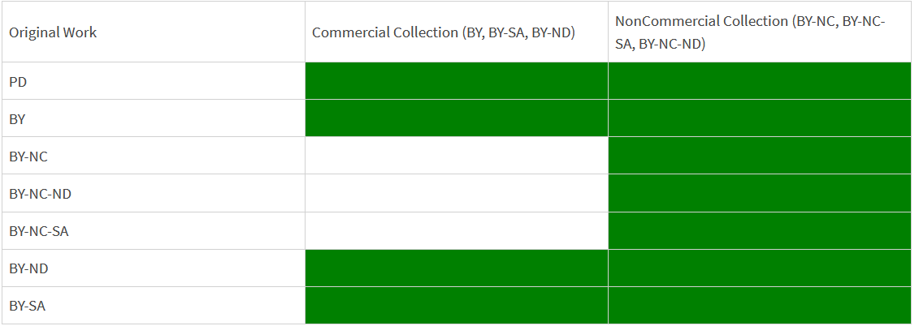
Choosing a Compatible License for a Collection
Collection License Chart, by Creative Commons, is licensed under a Creative Commons Attribution 4.0 International license
If you want to use works that are licensed BY-NC, BY-NC-ND, or BY-NC-SA, then you can only include them in a collection that will have an NC license as well, in order to abide by the restrictions of the Non-Commercial license clause.
If your collection does not include works that are licensed BY-NC, BY-NC-ND, or BY-NC-SA, on the other hand, you can choose any of the CC-licenses (BY, NC, NC-ND, NC-SA, ND, or SA) to your completed collection.

Slide 10
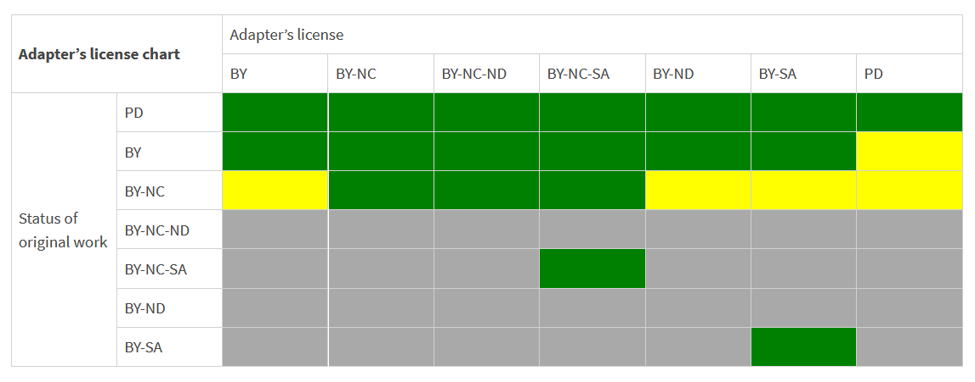
Choosing a Compatible License for a Remix
Adapter’s License Chart, by Creative Commons, is licensed under a Creative Commons Attribution 4.0 International license
License your remix with a license that is compatible with the most restrictively-licensed work in the remix.
If your remix includes a works that are licensed BY-NC and BY-NC-SA, then you should choose the BY-NC-SA license to your completed remix, in order to accommodate your most restrictive license.
If your remix includes works that are all licensed CC-BY, you can choose any of the CC licenses to your completed remix.

Slide 11
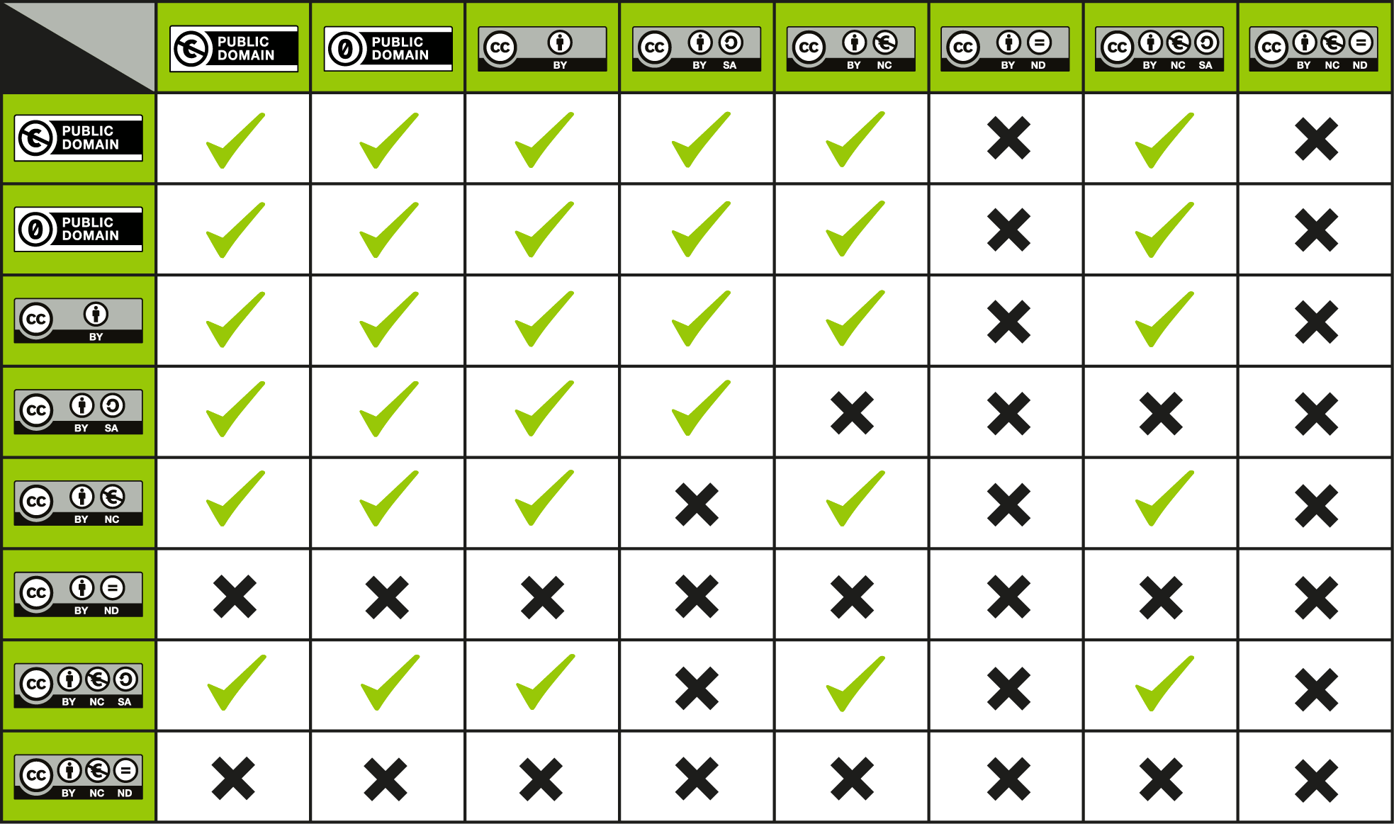
CC license compatibility
Check the compatibility before creating a new work using CC licensed elements!
Important: anything with an ND license can’t be used to make derivative works in the first place!

Slide 12
Examples

Slide 13

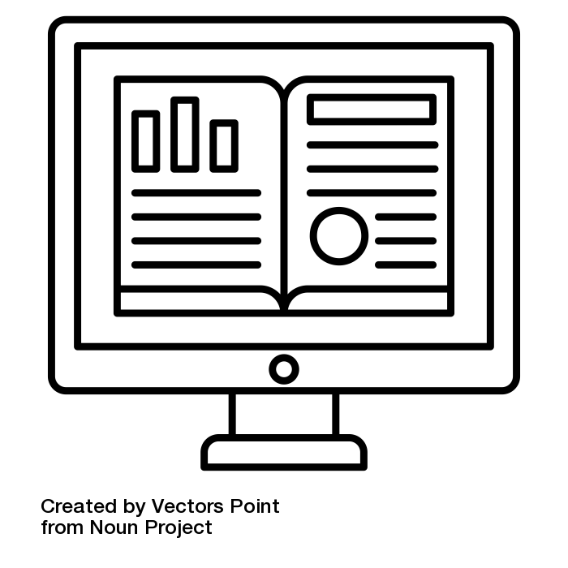

A collection
Attribution:
Librarian by Andre Buand from Noun Project (CC BY 3.0)
ebook by Vectors Point from Noun Project (CC BY 3.0)
Tablet by supeni from Noun Project (CC BY 3.0)
Available Library Services
This collection “Available Library Services” by Chris Chang is licensed under a Creative Commons Attribution 4 International License.

Slide 14
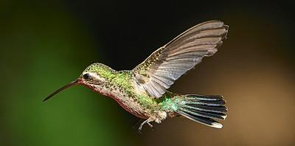

A remix
Attribution: Gray Hiarstreak by Andy Reago and Chrissy McClarren CC BY 2.0 https://flic.kr/p/2oRGnJi
Broad bill hummingbird by Henry CC BY 2.0
https://flic.kr/p/2oRD3X7
This work “A Remixed Bird” by Chris Chang is licensed under a Creative Commons Attribution 4 International License.

Slide 15
Thank You!

