Slide 1
Creative Commons for Academic Librarians
CC BY 4.0, 2023, Chris Chang
“Creative Commons for Academic Librarians” by Chris Chang is licensed under a Creative Commons Attribution 4.0 International License.
Notes:
Licensed under a Creative Commons Attribution 4 International License

Slide 2
Open Access

Slide 3

What is Open Access?
Open access (OA) literature is “digital, online, free of charge, and free of most copyright and licensing restrictions”. The recommendations of the Budapest Open Access Declaration—including the use of liberal licensing (such as CC BY)— is widely recognized in the community as a means to make a work truly open access.
Open access resources are still credited and peer reviewed. The only difference from non open access resources is that the publishing cost is not paid by the readers.

Slide 4
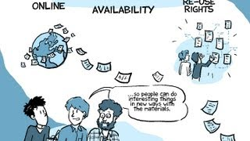
Open Access Explained!
“Open Access Explained!” by PHD Comics is licensed with Creative Commons Attribution

Slide 5
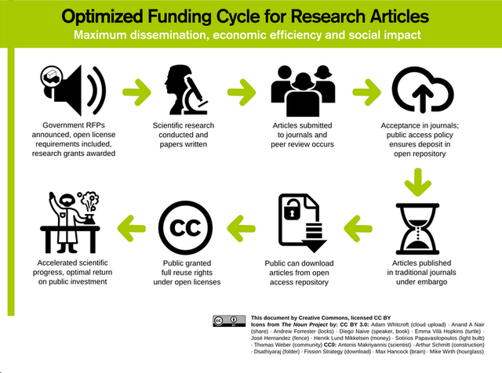
Open Access Publishing
Open access journals are publishing Creative Commons-licensed research, which promotes access and re-use of scientific and scholarly research.

Slide 6
Typess of OA
Green OA: published in self archives (e.g. arXiv) or institutional repositories. Peer review is not required.
Gold OA: published in an open access journal or publisher’s website. Peer reviewed. Authors retain copyrights.
Hybrid OA: subscription journals give their authors the option of making their articles open access
Diamond OA: complete free to publish and to read (e.g. https://www.diamondopen.com/journals-list/)
Bronze OA: often free to read but without clear licensing information

Slide 7
Open Educational Resources

Slide 8

Definition of OER
Open Educational Resources (OER) are any type of educational materials that are either in the public domain, or published under open licenses (e.g. Creative Commons) that specify how materials can be used, retained, adapted, shared and modified according to specific needs. They can include textbooks, lecture notes, syllabi, assignments and tests.

Slide 9

What is OER?
“Open Educational Resources concept: What is an OER?” by UNESCO is licensed with Creative Commons Attribution

Slide 10
OA vs. OER
OER are always Open Access, but not all OA materials are OER.
OA means accessing without cost but not necessarily copyright free.
OER means that the copyright owners made the resources free for use. It is often licensed with a Creative Commons License.
OA
OER

Slide 11
Benefits of OA and OER

Slide 12
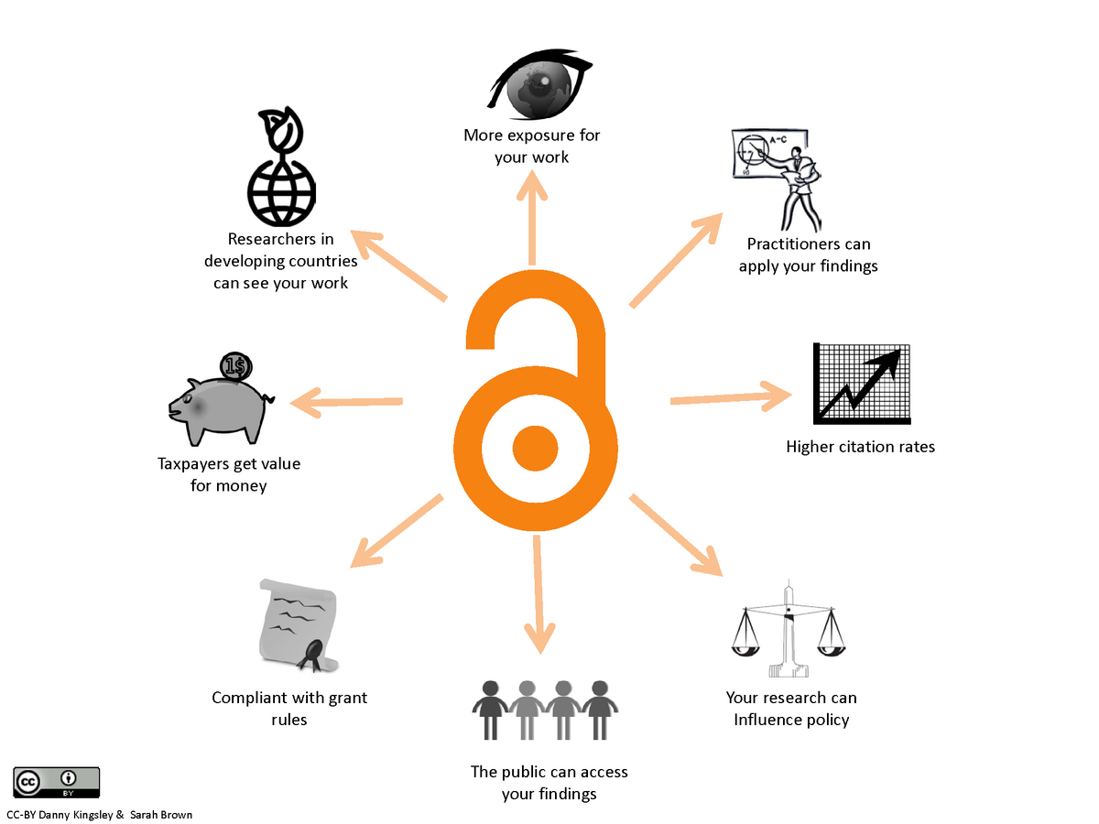
Why Open Access? (faculty and students)
With Open Access, faculty and students can freely read researches around the world.
Open Access makes research more visible, transparent, and available for readership, citation, and collaboration.
Read more about the benefits of Open Access on SPARC’s website.

Slide 13
Why OER? (Benefits for students)
Accessibility: students anywhere in the world can access OER for almost no cost
DEI opportunities: students can modify the material to reflect their cultural context and contribute
Innovation: the new and innovative additions can be easily added for improvement
Continuing education: the resource will stay available, so students can review on their own, even after graduation

Slide 14
Why OER? (Benefits for faculty)
Lowers students financial burden for cost of attendance
Students are engaged from day 1, because they can access the textbook even before the course
Easy enhancement of course content using OER ancillary
Can be easily modified to meet the course needs
Diverse voices can be added and reflected
OERs will continue to be improved, even after the course is over.

Slide 15
Thank You!

