Slide 1
CARLI MEMber Oer Initiative Information Session
February 24, 2026

Slide 2
Purpose
To provide financial support to CARLI member libraries to:
Increase the awareness and use of Open Educational Resources (OER)
Make access to course materials more equitable and affordable
Develop new or maintain existing OER programs
https://www.carli.illinois.edu/products-services/collections-management/OERInitiative
Notes:
The CARLI Member OER Initiative will provide financial support to CARLI member libraries to increase the awareness and use of Open Educational Resources (OER) at their institutions. By enhancing student and faculty success through open educational practices, members will make access to course materials more equitable and affordable, while impacting the CARLI community and the State of Illinois through the sharing of institutional resources. The funds set aside by the CARLI Governance Board will be awarded in this OER Initiative for the purpose of helping CARLI member institutions either develop new or maintain existing OER programs.

Slide 3
What is different?
Unlike past OER funding initiatives, this is NOT a grant!
CARLI will award funds for services rendered (i.e. the development of an OER program or creation of OER) through a purchase order.

Slide 4
Who can apply?
All CARLI member libraries may apply
Faculty interested in applying should contact their institution's library. The Project Director must be a library faculty or staff member, and your library team can help facilitate the application process.
The application must be signed by the governing authority for your institution; an individual with the authority to receive and administer purchase order funds on behalf of your institution.

Slide 5
CARli member oer initiative Eligible Activities

Slide 6
Eligible activities
Raise awareness of Open Education Resources among faculty, staff, and students through activities including campaigns, teaching faculty or student workshops, and library personnel training
Increase engagement at CARLI member libraries through activities that result in the expansion of OER usage in the classroom through adoption, adaptation, and/or creation
Save students at Illinois institutions of higher education the cost of textbook costs beginning in the 2027-2028 academic year
Advance student learning through improved collaboration, engagement, responsiveness, and curricular relevancy
Notes:
The CARLI Member OER Initiative will support member libraries as they work toward equitable access to course materials, lower materials costs for students, and help contribute to their retention, progression, and graduation. Proposals can include one or more awareness and engagement activities, based on campus priorities and needs:

Slide 7
Eligible activities - examples
Spotlighting faculty using OER through profiles or an OER champions campaign
Highlight student stories of textbook cost impacts or conduct your own surveys to learn more about faculty OER perceptions or student textbook impacts on your campus; work to publish findings
Pursue librarian-specific training or lead/ bring to campus training for relevant stakeholders outside the library
Build campus-specific collections of OER in the Open Illinois - CARLI’s OER Commons Hub, LibGuides, or on another platform
Develop a campus OER Working Group/Committee
Plan a schedule of events for Open Education Week
Launch a campus-wide Faculty OER funding program to offer incentives and/or support for any of the following activities
Notes:
Please note – these are merely suggestions of the types of activities you can include in your proposal.
We encourage you to be creative and develop a program that best suits the needs of your campus, faculty, and students

Slide 8
Eligible activities - examples
Review an open resource in the Open Textbook Library, LibreTexts, or OER Commons
Adopt an OER textbook in place of a commercial textbook for and create new ancillary materials to support the adoption
Adapt existing OER to fit the learning outcomes of a particular course and adopt these new materials in place of commercial materials
Create new OER to adopt in place of a commercial textbook
Engage in continuous improvement, revising or enhancing OER materials currently in use but in need of improvement or additional supports for students, including to improve accessibility
Design open pedagogy projects to engage students in OER

Slide 9
Funding Levels
Each CARLI member library may submit one proposal. You may choose one of three categories:
Level 1 up to $7,000
Level 2 up to $15,000
Level 3 up to $30,000
CARLI will fund approximately $300,000 in total for the CARLI Member OER Initiative.
Proposals may NOT include indirect costs.
Notes:
Please note, each institution may only submit one proposal for the CARLI member OER initiative (this differs from past calls for funding.)
You application may include one activities or multiple activities, you must choose the category of funding that best suits your needs.
Once chosen you cannot request additional funds.

Slide 10
Program requirements
Include the CARLI Open Illinois logo and acknowledge the funding received through the CARLI Member OER Initiative
Have a Creative Commons Attribution 4.0 International / CC-BY 4.0 International license
Be available at no cost to students, faculty, and staff; or be available for the cost of printing for printed materials
Be shared to accessible repositories including as applicable CARLI's OER Commons Hub - Open Illinois, LibreTexts, and the Open Textbook Library
Meet Americans with Disabilities Act Title II Regulations for digital accessibility
Commit to data collection and sharing that information with CARLI for up to 3 years following the end of the program period; more details will be shared soon.
All materials created as a result of CARLI Member OER Initiative should be updated and used for at least three years after the program ends.
Notes:
All materials and resources created with funding from the CARLI Member OER Initiative must:

Slide 11
Timeline
March 31, 2026: Proposals due by midnight
April 2026: Proposals under review
May 11, 2026: Funded proposals announced
June 30, 2026: Purchase Orders complete by this date
Projects may begin after project purchase order issued
October 15, 2026: Quarterly Report due
January 15, 2027: Quarterly Report due
April 15, 2027: Quarterly Report due
July 15, 2027: Quarterly Report due
October 15, 2027: Quarterly Report due
January 15 2028: Quarterly Report due
April 15, 2028: Quarterly Report due
June 30, 2028: Initiative ends; all funds expended
July 15, 2028: Final Report due

Slide 12
Instructions for Proposal Submission Proposal Submission

Slide 13
Proposal Submission
All proposals must be submitted using the online form.
All sections of the form are required.
Each CARLI Member may submit ONE proposal.
Proposals are due by midnight on March 31, 2026.
Notes:
CARLI has created on online form to submit your proposal.
We recommend reviewing the form as a Word document. – fill in the word doc then cut and paste into the online form so you don’t lose your submission - https://www.carli.illinois.edu/sites/files/coll_man/202602_CARLI_Member_OER_Initiative_Application_Word_Version_for_Reference.docx
You can cut and paste information into the form. You can complete the form in multiple sessions; however, your browser cookies must be enabled so that you can continue with the same submission.

Slide 14
Proposal Submission
Proposals are due by midnight on March 31, 2026.
Proposals include:
Project Details
Budget and Budget Narrative [Please see Budget Exclusions on this webpage.]
Application Narrative: Describe the project as a whole, with goals and metrics for assessing success. Include outputs, outcomes, and impact. Provide a detailed timeline for activities.
START YOUR SUBMISSION
Notes:
https://illinois.qualtrics.com/jfe/form/SV_6nhP4GnsDMWws3c

Slide 15
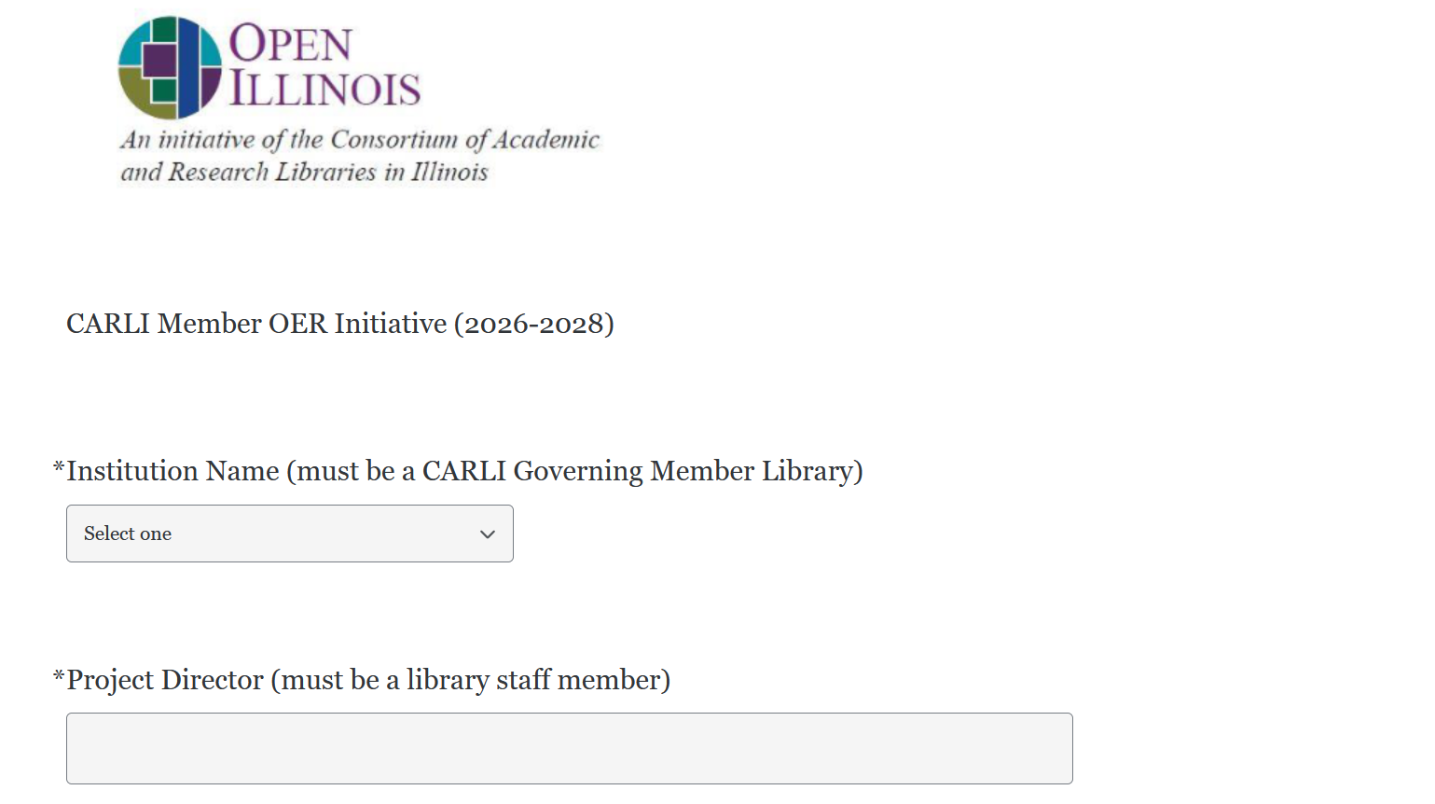
Proposal Submission

Slide 16
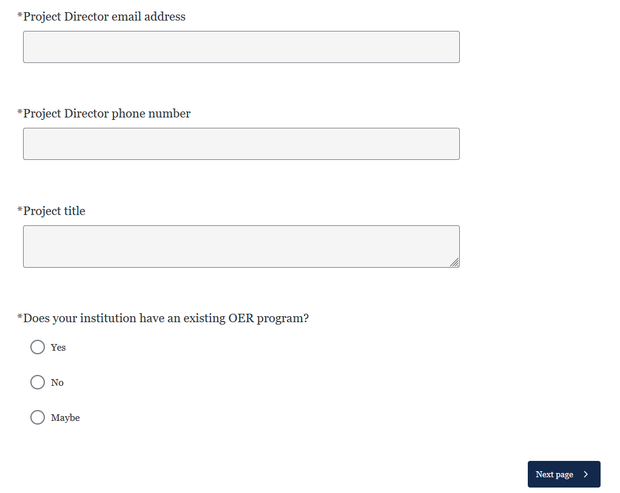
Proposal Submission

Slide 17
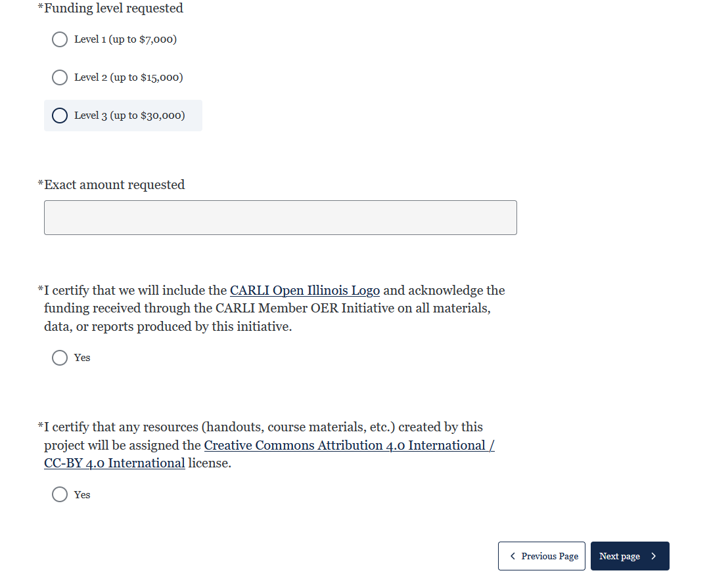
Proposal Submission

Slide 18
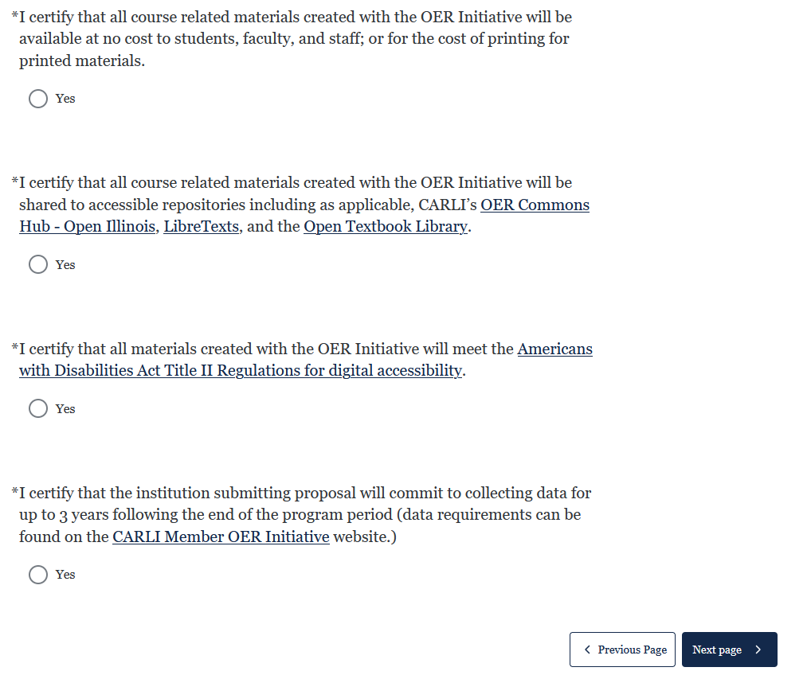
Proposal Submission

Slide 19
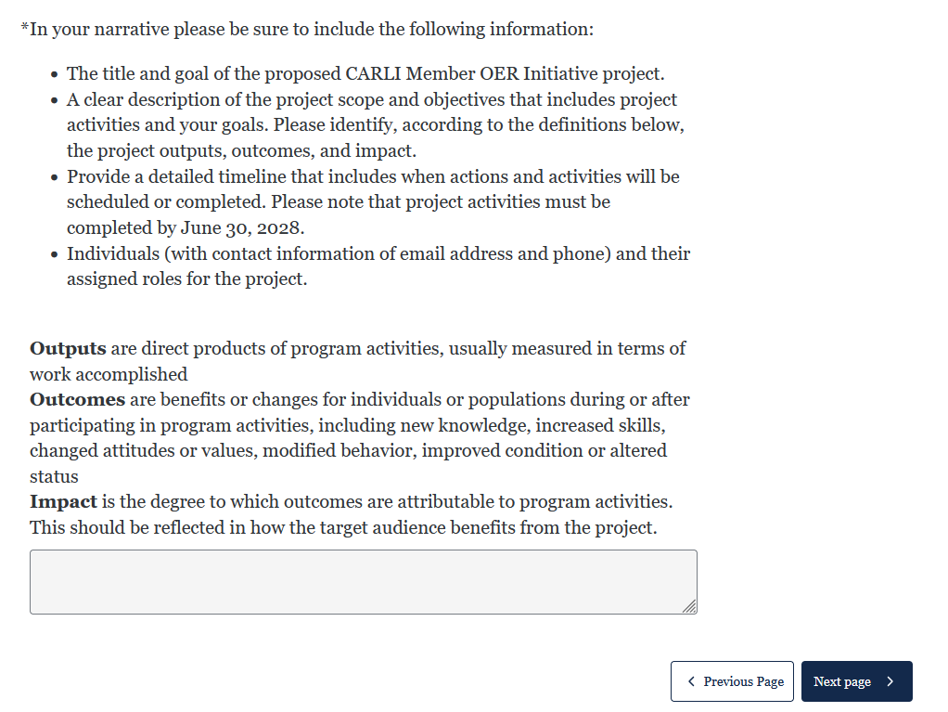
Proposal Submission

Slide 20
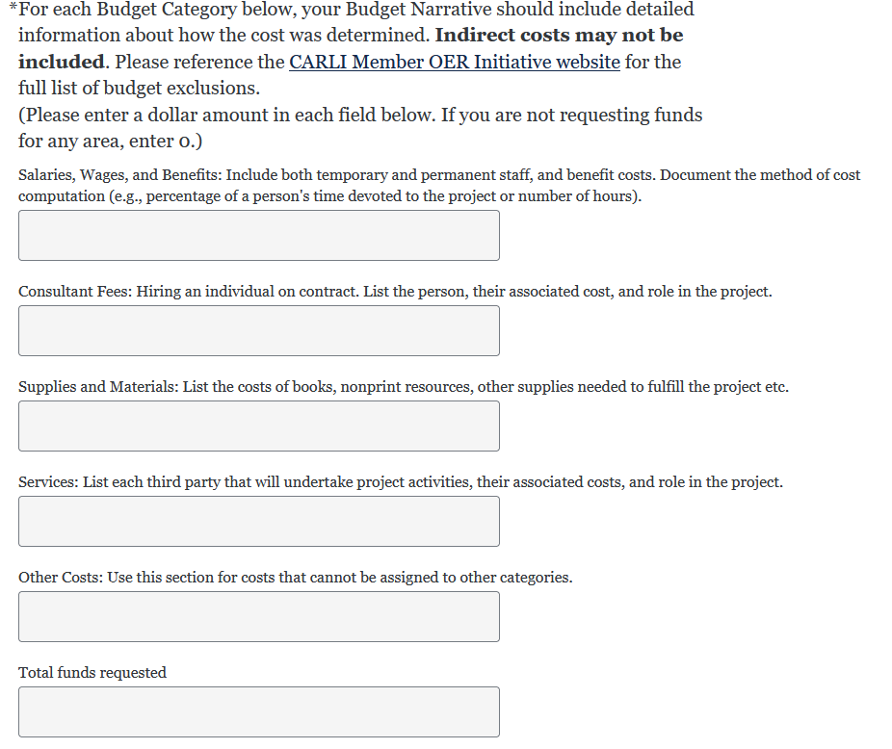
Proposal Submission

Slide 21
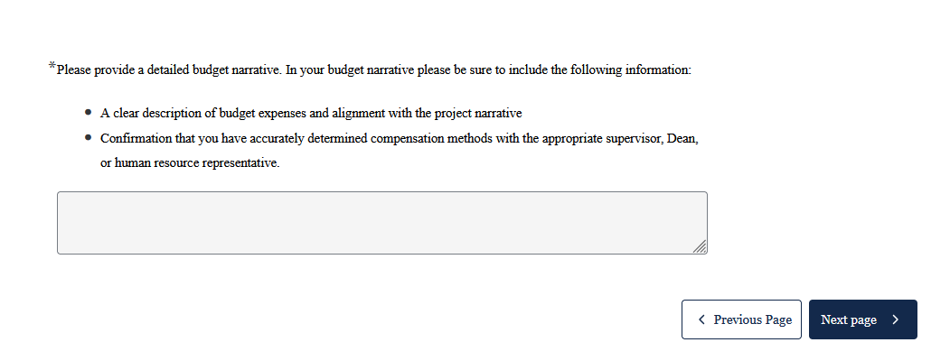
Proposal Submission

Slide 22
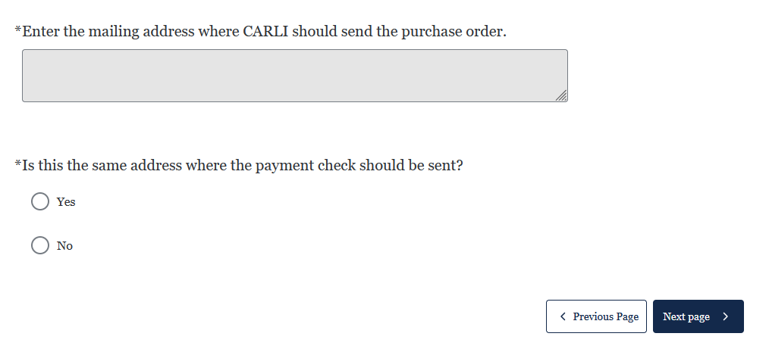
Proposal Submission

Slide 23
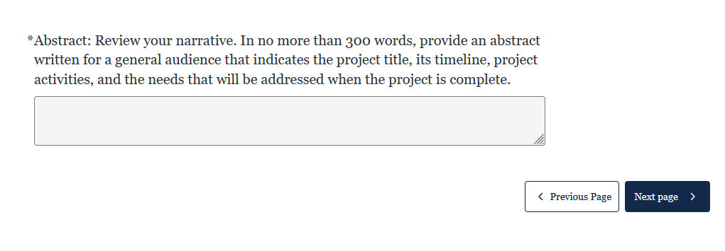
Proposal Submission

Slide 24
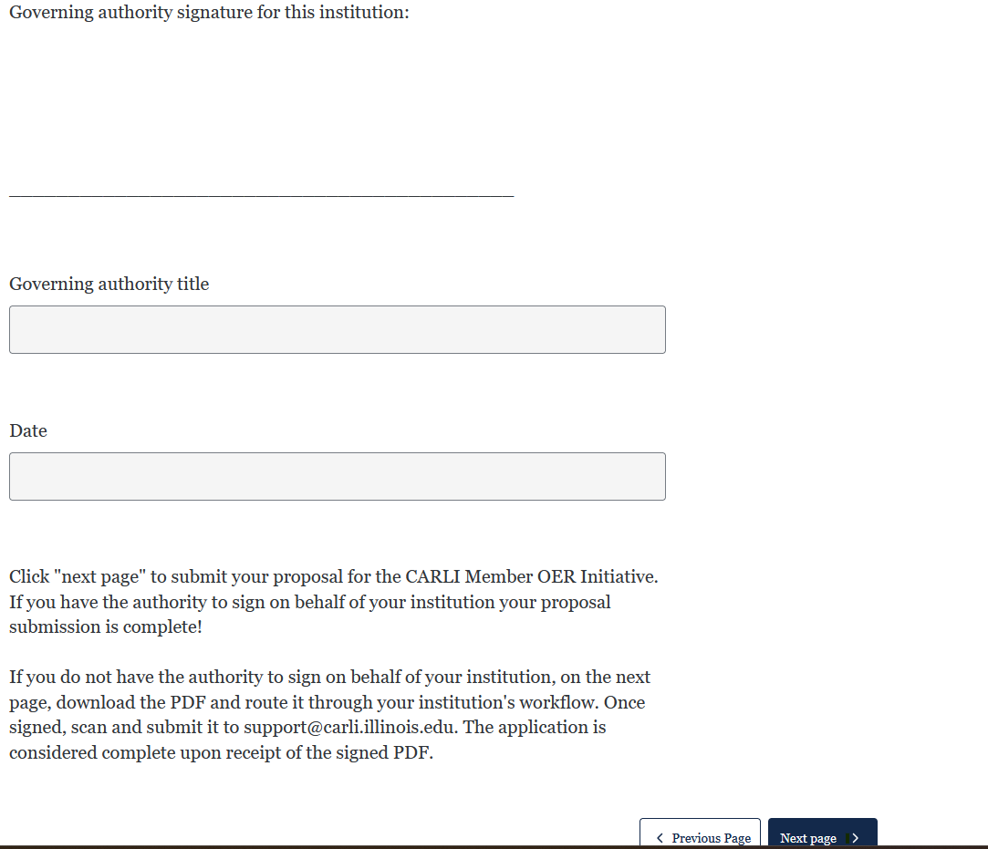
Proposal Submission
Notes:
If you have the authority to sign on behalf of your institution: complete the following section and click on submit this form. Your proposal is then complete. If you do not have the authority to sign on behalf of your institution: leave the signature, title, and date blank and submit this form. On the next page download the PDF route it through your institution's workflow to have the PDF signed. Once signed, scan and submit it to support@carli.illinois.edu. Your proposal is considered complete upon receipt of the signed PDF.

Slide 25
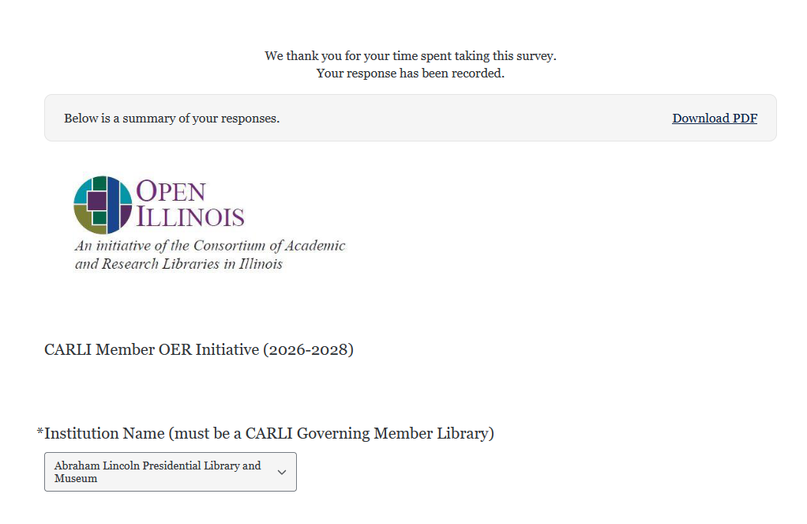
Proposal Submission
Notes:
Click "next page" to submit your proposal for the CARLI Member OER Initiative. If you have the authority to sign on behalf of your institution your proposal submission is complete! If you do not have the authority to sign on behalf of your institution, on the next page, download the PDF and route it through your institution's workflow. Once signed, scan and submit it to support@carli.illinois.edu. The application is considered complete upon receipt of the signed PDF.

Slide 26
Budget Exclusions
Funds received from the CARLI Member OER Initiative may not be used for the following items.
Do not include them in your budget.
Indirect Costs
Alcohol
Conference registrations & travel
Donations
Entertainers
Equipment
Gift cards
Memberships
Software (including other publishing platforms)

Slide 27
Evaluation Criteria
The rubric includes the following criteria on which all applications will be evaluated:
Budget and Budget Narrative: Project provides justification of all expenses. As succinctly as possible, the budget should reflect the outcomes of the project. No vague expenses listed.
Project / Action Plan: The project is thoroughly described and a detailed plan for the project is included.
Clarity and Alignment: The project's essential elements including the proposal, budget, and timeline are included and clearly indicate how the project will be accomplished.
Potential for Impact: Clear outputs, outcomes, and impacts (defined below). Clear plans for how the results will be achieved.
Outputs are direct products of program activities, usually measured in terms of work accomplished
Outcomes are benefits or changes for individuals or populations during or after participating in program activities, including new knowledge, increased skills, changed attitudes or values, modified behavior, improved condition or altered status
Impact is the degree to which outcomes are attributable to program activities. This should be reflected in how the target audience benefits from the project.
Notes:
All proposals will be evaluated by CARLI staff and may include reviewers comprised of past and current CARLI OER Committee members.
Institutions without an existing OER Program will receive special consideration.

Slide 28
Disbursement of Funds for Selected Projects
The process for the disbursement of funds begins with the issuance of a purchase order by the University of Illinois on behalf of CARLI.
Libraries will submit an invoice for 70% of the funds upon issuance of the purchase order.
To receive the remaining 30% of funds, libraries must submit a project review statement that includes accomplishments to date and indicates that they have completed 70% of their project.
After CARLI reviews the statement and confirms the project status, libraries must submit a second invoice for the remaining funds.
Notes:
All proposals will be evaluated by CARLI staff and may include reviewers comprised of past and current CARLI OER Committee members.
Institutions without an existing OER Program will receive special consideration.

Slide 29
Reach out
For questions about the CARLI Member OER Initiative, please contact: support@carli.illinois.edu
You can also check our Frequently Asked Questions (FAQ) page: https://www.carli.illinois.edu/carli-member-oer-initiative-questions-and-answers

